Slide 1

Fast and Efficient Solvers Project
Iurii Minin
Mozhdeh Shiranirad

Slide 2
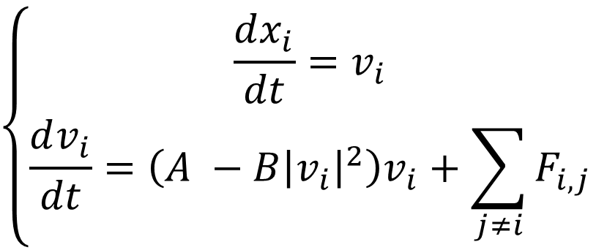


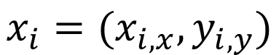
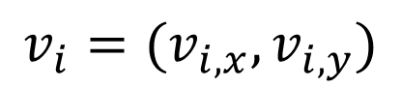
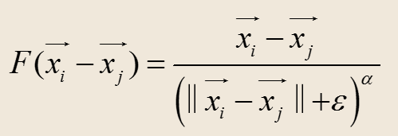
Problem Statement:
Particle interaction force

Slide 3
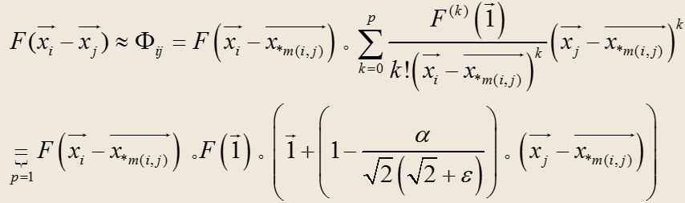
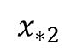
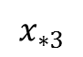
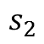
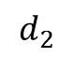
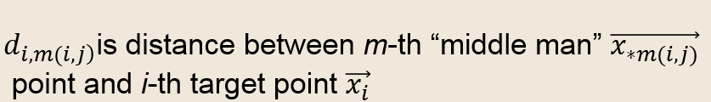
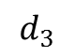
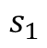
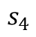
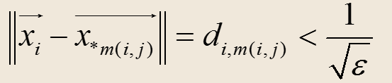
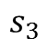
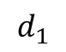
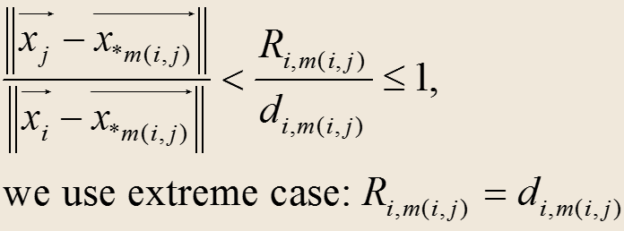
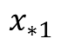
Middle Man :
Derived R- Expansion for
Derived R-expansion constraints:
T
1.
2.

Slide 4
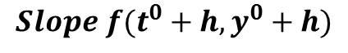
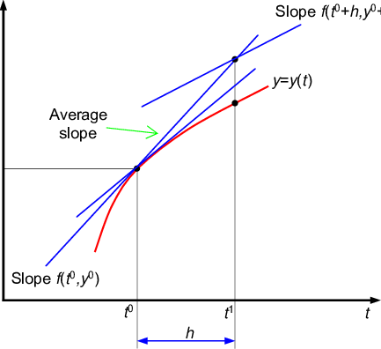
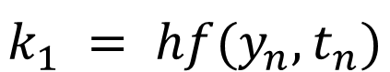
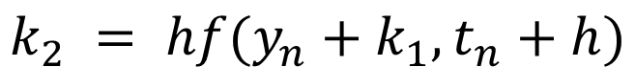
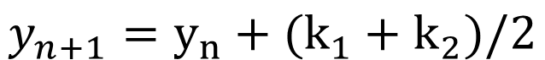
Second Order Runge-Kutta Method:

Slide 5
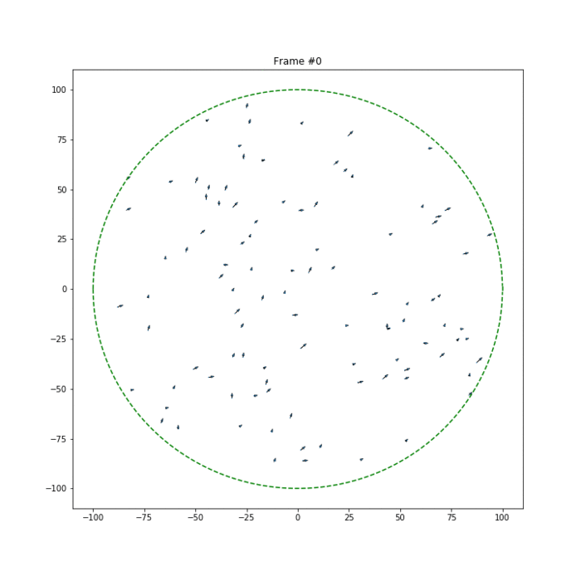
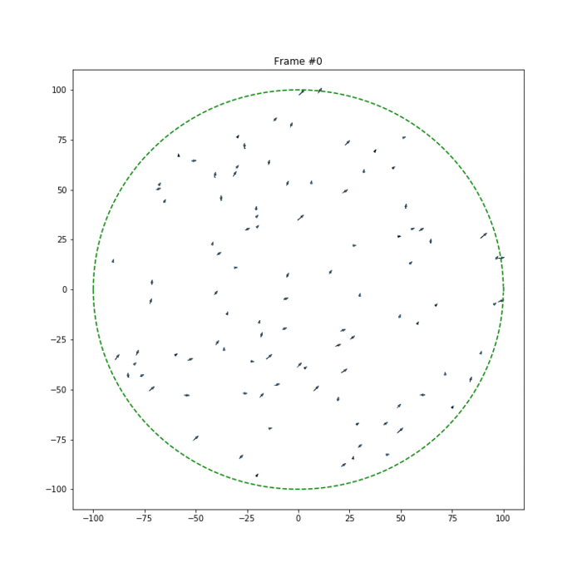
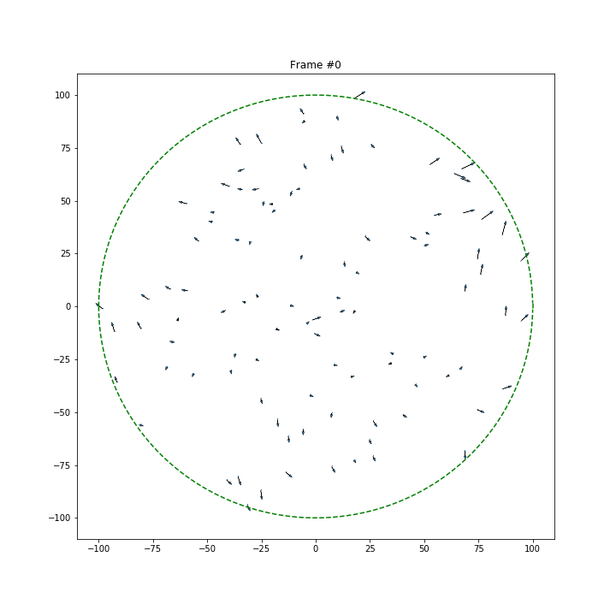
Representation of the results:
N = 100, A = B = 5, epsilon = 0.0001. Forces are inverse. 1 reflecting.
h = 0.0001 h=0.001 h=0.01

Slide 6
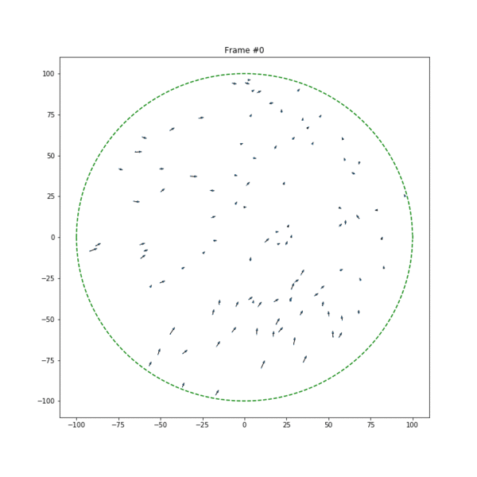
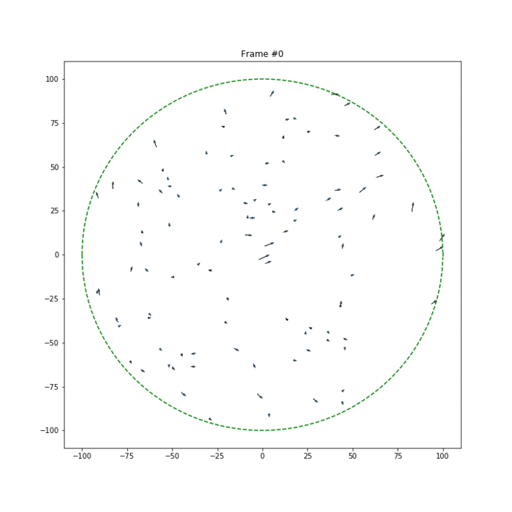
A = B = 5; N = 100; epsilon = 0.0001; alpha = 1; h = 0.01. Two reflectings?
Forces are inverse
Forces are direct (Black hole)

Slide 7
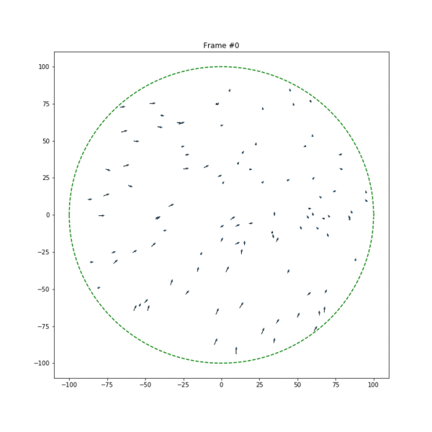
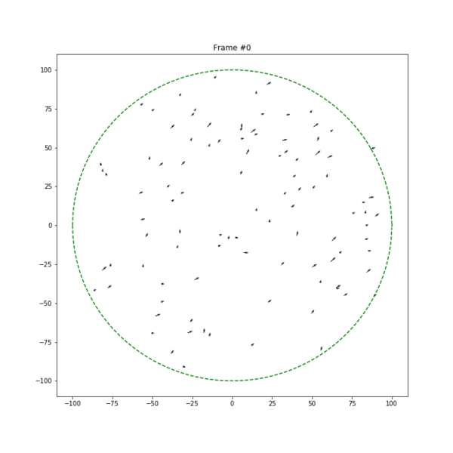
A = 0; B = 10; N = 100; epsilon = 0.0001; alpha = 1; with double reflection
Forces are direct; h = 0.01. (Black hole)
Forces are inverse; h = 0.001.

Slide 8
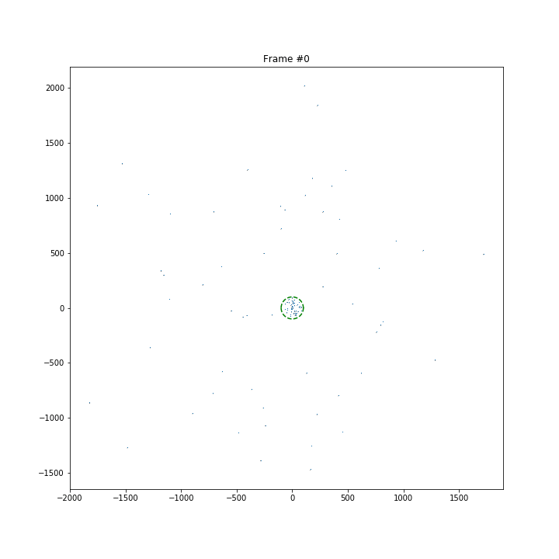
A = 10; B = 0; N = 100; epsilon = 0.0001; alpha = 1; with double reflection
Forces are direct; h = 0.01.
Forces are inverse; h = 0.001.

Slide 9
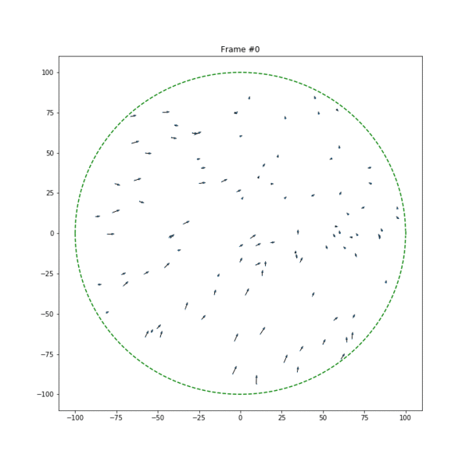
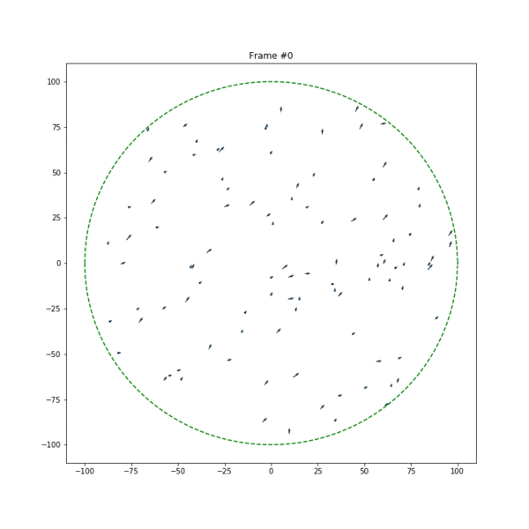
A = 0; B = 0; N = 100; epsilon = 0.0001; alpha = 1; h = 0.01; with double reflection
Forces are inverse
Forces are direct

Slide 10
which kind of steady-state (equilibrium state) can exist in such kind of systems?
Will all the particles “run” into the state of black hole or self-organize into some structures?

Slide 11
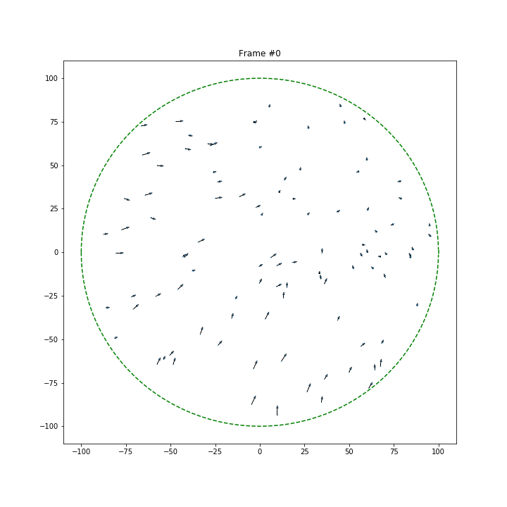
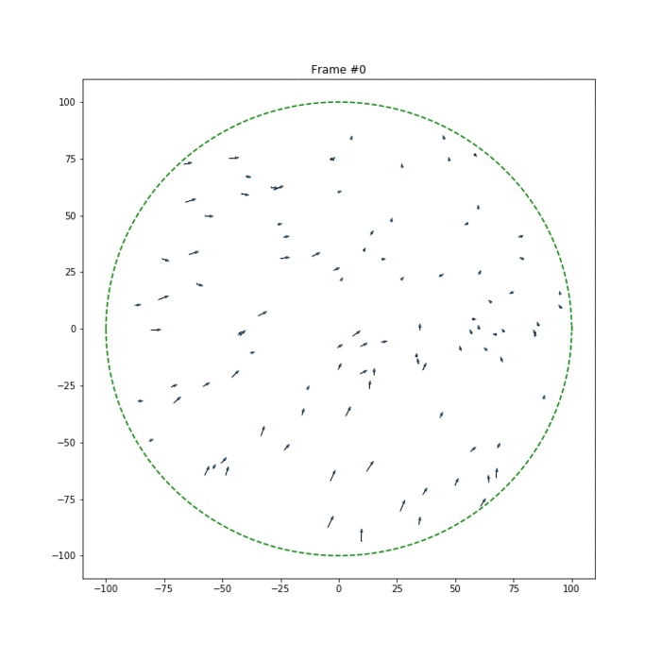
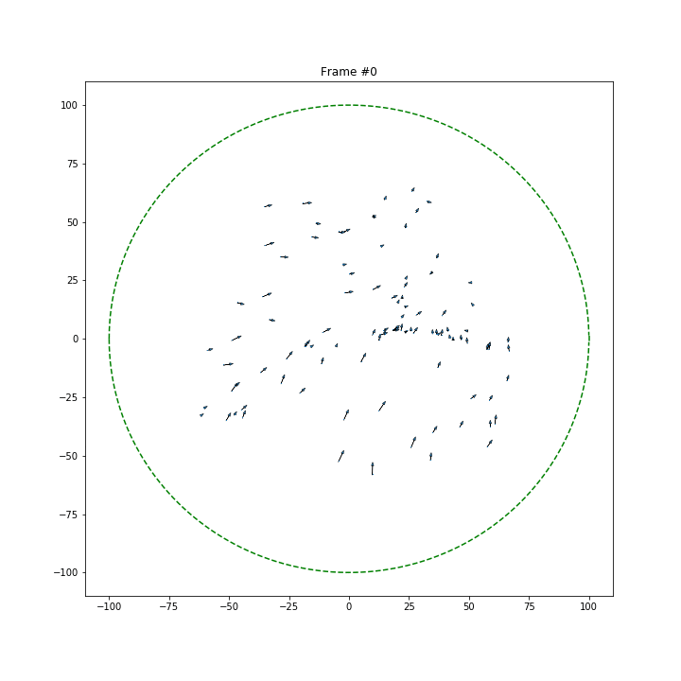
Experiment with different A,B
A=0
A=2
A=4
A=6
A=8

Slide 12
Experiment with different epsilon

Slide 13
Experiment with different alpha

Slide 14
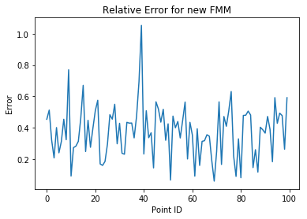
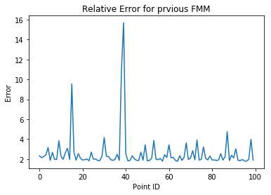
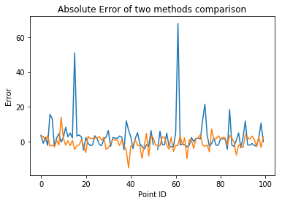
Error Analysis
Notes:
New FMM is the FMM with adjusted middle points

